Slide 1
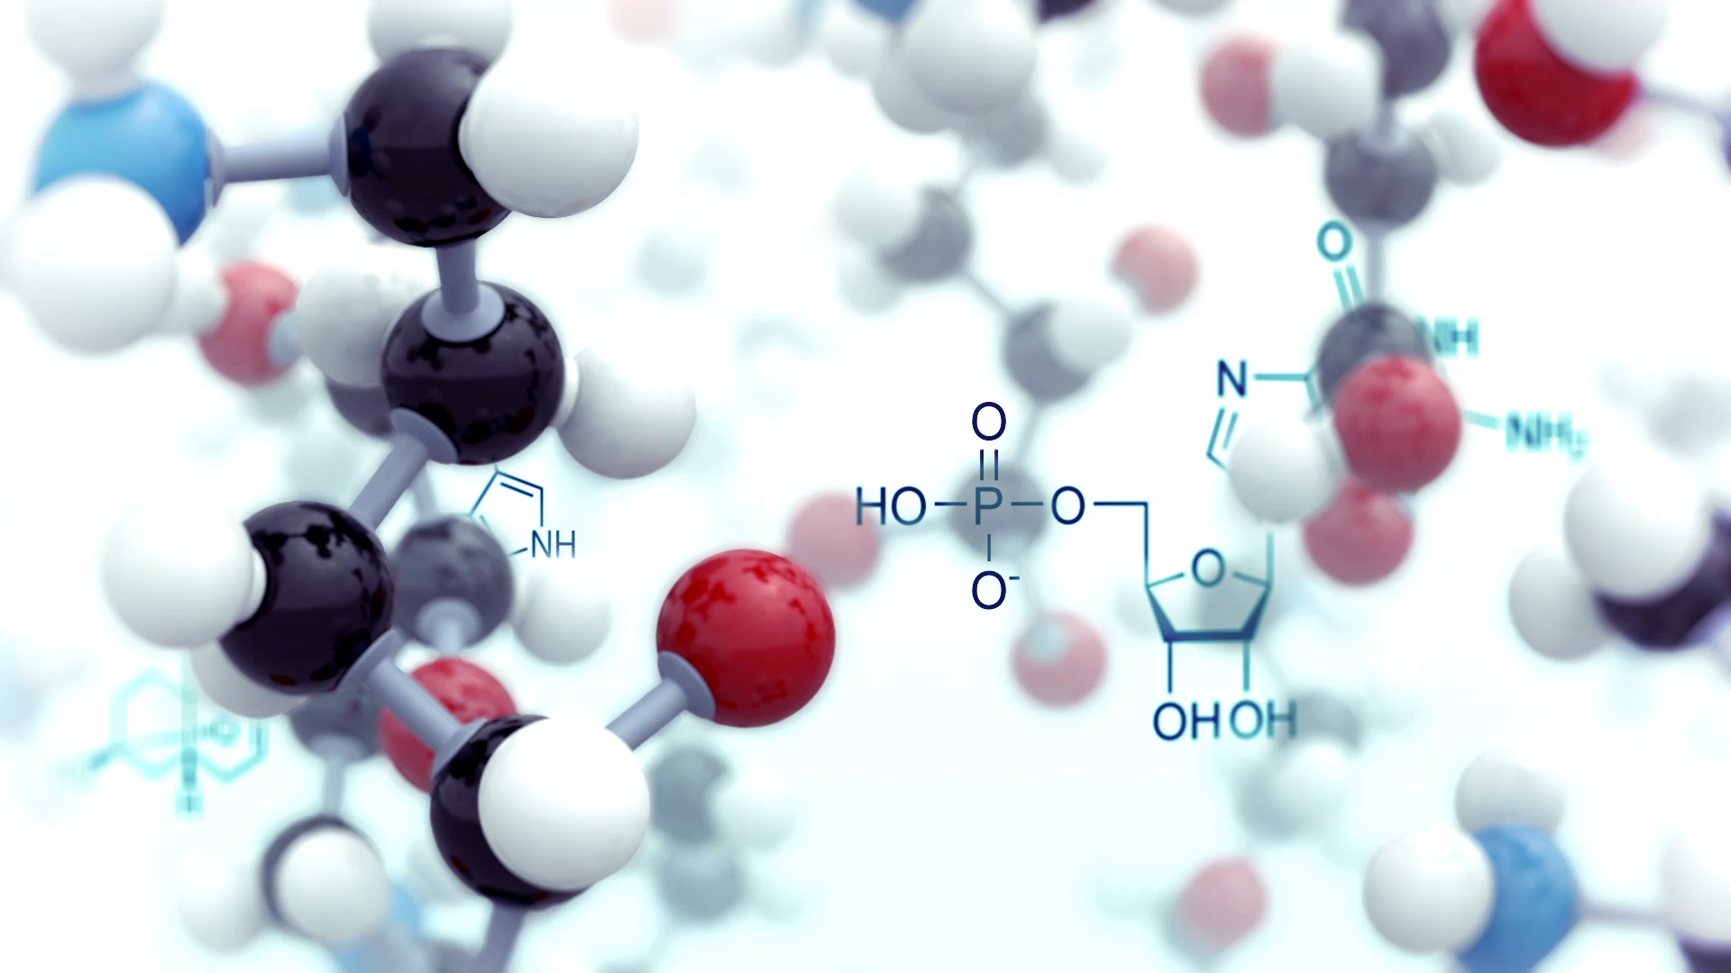
Mass Relationships in Chemical Reactions
Unit 3

Slide 2
Chemical Reactions
Stoichiometry
Limiting and Excess Reactants
Reaction Yield
Key Topics:
Balancing Chemical Reactions
Chapter 3 etextbook
2

Slide 3
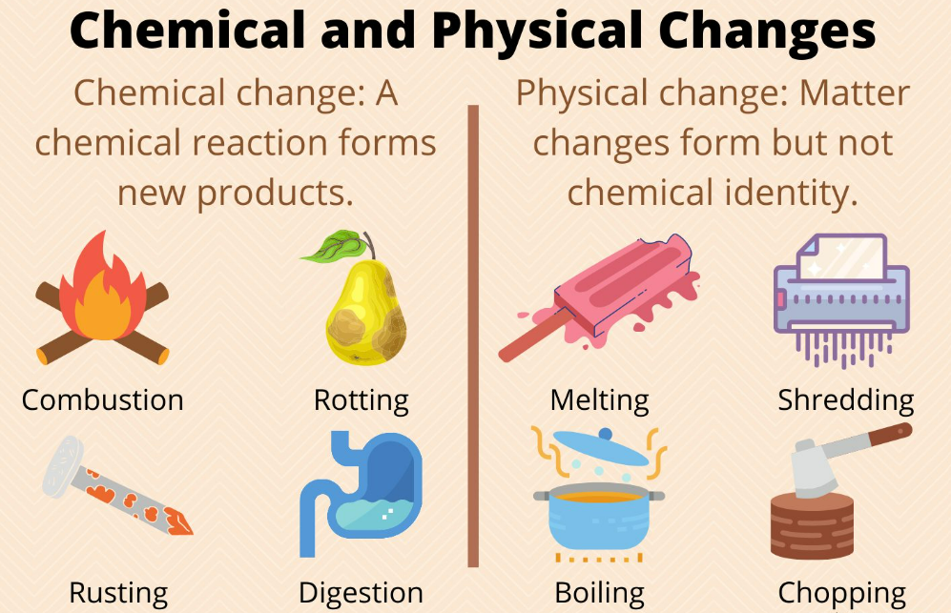
Chemical Reactions
Process by which substance(s) is(are) converted to different substance(s).
Reactants Products
Notes:
https://sciencenotes.org/chemical-and-physical-changes-of-matter/

Slide 4
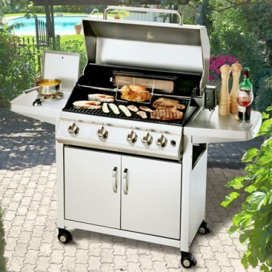
Chemical Reactions, continued
Example: Combustion
When methane gas (main component of natural gas) combines with oxygen gas in the air and burns, it produces carbon dioxide gas and pure water.
States:
(g) = gas
(s) = solid
(l) = liquid
(aq) = aqueous
methane + oxygen → carbon dioxide + water
CH₄ (g) + O₂(g) → CO₂(g) + H₂O(l)
reactants
products

Slide 5
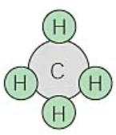


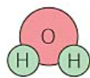
Chemical Reactions, continued
CH₄ (g) + O₂(g) → CO₂(g) + H₂O(l)
Unbalanced Equation:
Conservation of mass
Balanced Equation:
Notes:
https://web.fscj.edu/Milczanowski/psc/lect/Ch11/slide3.htm

Slide 6
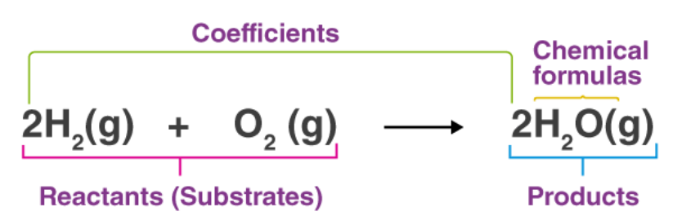
Balancing Equations
Law of the Conservation of mass
  Matter is neither created nor destroyed. It is only transferred.
  Numbers, and types of atoms, are identical on both sides of the reaction.
  Represented by a balanced chemical equation.
Notes:
e-states-chemical-change-matter-neither-created-destroyed-vector-diagram-image178574876

Slide 7
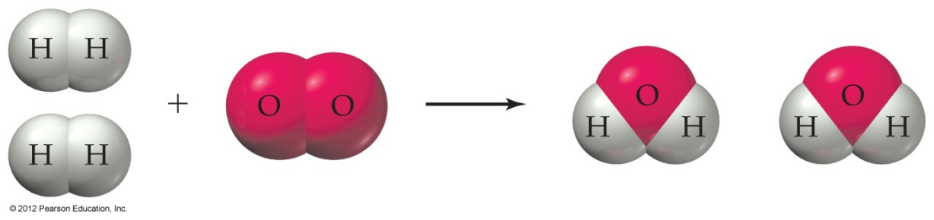
Balancing Equations, continued
2H₂(g) + O₂(g) → 2H₂O(l)
Microscopic:
____ molecules of hydrogen gas (or ___ hydrogen atoms).
____ molecule of oxygen gas (or ___ oxygen atoms).
____ molecule of liquid water (or ___ hydrogen atoms and ___ oxygen atoms).
Macroscopic:
2 moles of hydrogen gas (or 4 moles of hydrogen atoms).
1 mole of oxygen gas (or 2 moles of oxygen atoms).
2 moles of liquid water (or 4 moles of hydrogen atoms and 2 moles of oxygen atoms).
7

Slide 8

Balancing Equations, continued
Keep in mind:
Conservation of mass – atoms cannot be created or destroyed
NEVER change identities (or formulas) of substances.
Balance a reaction ONLY by adding molecules (coefficients) of reactants & products.
$$xH_{2}(g)+yO_{2 }(g)→zH_{2}O(g)$$
Where x, y and z are the coefficients of the compounds
IMPORTANT: Never change subscripts!!

Slide 9
Balancing Equations, continued
TIPS:
Example: Hydrogen gas combines with oxygen gas to produce liquid water.
Write the unbalanced chemical equation using correct chemical formula for each substance.
What type of reaction is occurring? What are the reactants? Products? States?
Include coefficients to indicate how many formula units of each substance are needed to balance the equation.

Slide 10
Balancing Equations, continued
If needed, reduce coefficients to their smallest whole-number values by dividing all by a common divisor.
Trial-and-error
Fractions
Check to make sure numbers and kinds of atoms are the same on both sides of the equation.
10

Slide 11
Balancing Equations, continued
TIPS:
FIRST balance an element only IF it occurs in one compound on each side of the equation.
If one of the reactants or products exists as the free element (ex. O₂, H₂), balance it LAST.
Example: C₂H₅OH (l) + O₂(g) → CO₂ (g) + H₂O (g)
  Balance carbon atoms and hydrogen atoms first.
  Balance oxygen atoms last.
  Balanced equation:
  C₂H₅OH (l) + 3 O₂(g) → 2 CO₂ (g) + 3 H₂O (g)
Khan Academy: Balancing Chemical Equations (video 5:30)

Slide 12
Balancing Equations, continued
Question:
Ammonia gas reacts with oxygen gas and produces nitrogen monoxide gas and gaseous water under appropriate conditions at 1000°C. Write the balanced equation.
Answer:
Reactants: Products:
Reaction:
Balancing:
  H:
  N:
  O:
Coefficients can be fractions.
Preferred!
12

Slide 13
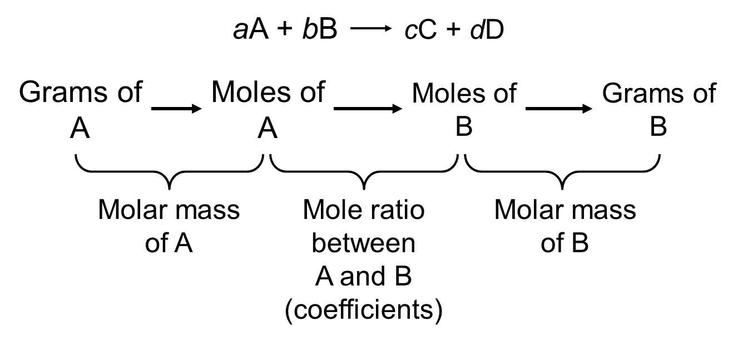
Stoichiometry
Study of the quantities of materials consumed and produced in chemical reactions.
Use a balanced chemical equation to determine relative masses of reactants and products involved in a reaction.
Grams to Moles to Moles to Grams
13

Slide 14
Stoichiometry, continued
Steps for calculating masses of reactants and products in chemical reactions:
Balance the equation for the reaction.
Convert the masses of reactants - or products - to moles.
Use the balanced equation to set up the appropriate mole ratio(s).
Use the mole ratio to calculate the number of moles of the desired reactant, or product.
Convert from moles to masses.

Slide 15
Stoichiometry, continued
Question: Household bleach is an aqueous solution of sodium hypochlorite (NaOCl). It is prepared by reacting sodium hydroxide with chlorine gas as shown in the balanced equation below. How many grams of NaOH are needed to react with 25.0 g Cl₂?
2 NaOH(aq) + Cl₂(g)
NaOCl(aq) + NaCl(aq) + H₂O(l)
What do we want?
What do we know?
How do we get there?
15

Slide 16
Stoichiometry, continued
Question: How many grams of NaOH are needed to react with 25.0 g Cl₂?
Answer:
2NaOH(aq) + Cl₂(g)
NaOCl(aq) + NaCl(aq) + H₂O(l)
mole ratio:
2 : 1 : 1 : 1 : 1
1 mol Cl₂
2 mol NaOH
40.0 g NaOH
25.0 g Cl₂
×
×
×
= g NaOH
70.9 g Cl₂
1 mol Cl₂
1 mol NaOH
Molar mass of Cl₂
Mole ratio between
Cl₂ and NaOH
Molar mass of NaOH
Cl₂ mass → Cl₂ moles
NaOH moles → NaOH mass
Cl₂ moles → NaOH moles
16
Notes:
Remember significant figures.

Slide 17
Stoichiometry, continued
Propane, C₃H₈, when used as a fuel, reacts with oxygen to produce carbon dioxide and water according to the following unbalanced equation:
C₃H₈(g) + O₂(g) → CO₂(g) + H₂O(g)
Question:
What mass of oxygen will be required to react exactly with 96.1 g of propane?
What do we want?
What do we know?
Answer:

Slide 18
Stoichiometry, continued
How do we get there?
1. Balance the equation:
2. Convert mass of C₃H₈ to moles of C₃H₈:
3. Use the balanced equation and determine mole ratio of C₃H₈ to O₂:

Slide 19
Stoichiometry, continued
How do we get there?
4. Using the mole ratio, convert the moles of C₃H₈ to moles of O₂:
5. Convert the moles of O₂ to mass of O₂.

Slide 20
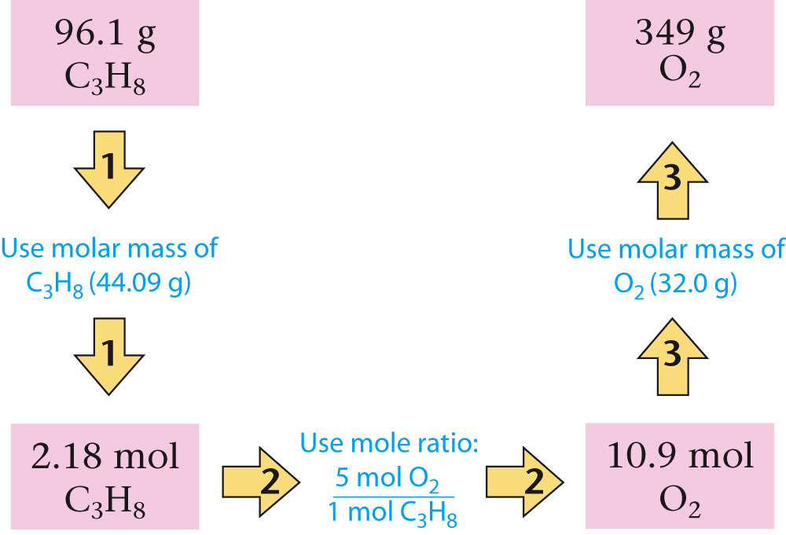
Stoichiometry, continued
Summary of calculations (dimensional analysis):
1
2
3
96.1 g C₃H₈ x 1 mol C₃H₈ x
44.09 g C₃H₈
5 mol O₂ x
1 mol C₃H₈
32.0 g O₂ = 349 g O₂
1 mol O₂
C₃H₈(g) + 5O₂(g) → 3CO₂(g) + 4 H₂O(g)

Slide 21
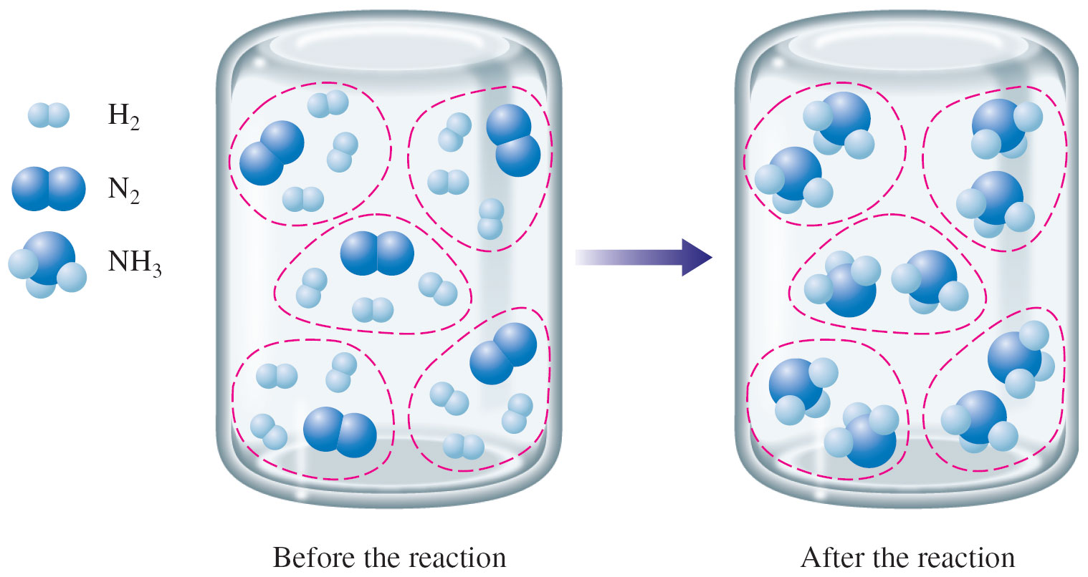
Limiting Reactants
Stoichiometric mixture – contains relative amounts of reactants that match the numbers in the balanced equation.
N₂(g) + 3H₂(g) → 2NH₃(g)
Nothing left over!

Slide 22
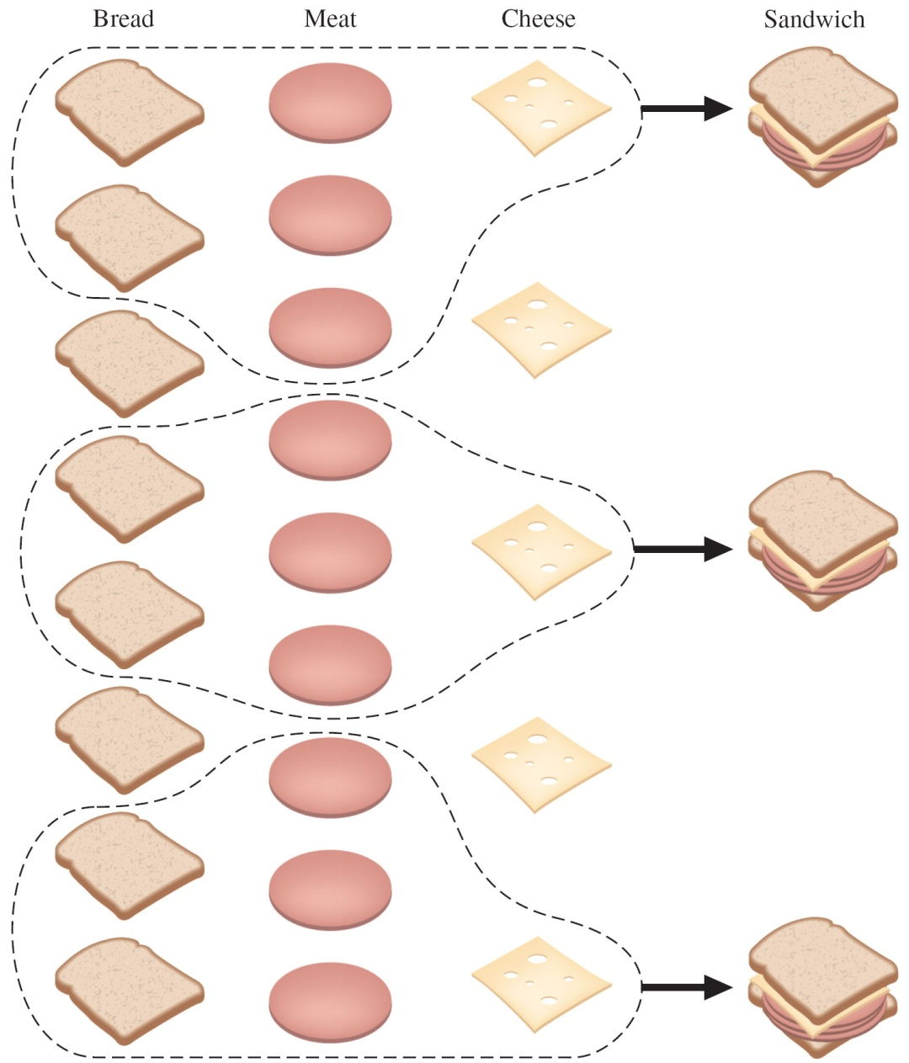
Limiting Reactants, continued
1 sandwich =
  2 slices of bread
  3 slices of meat
  1 slice of cheese
You have:
  8 slices of bread
  9 slices of meat
  5 slices of cheese
Which ingredient will be used up first?

Slide 23
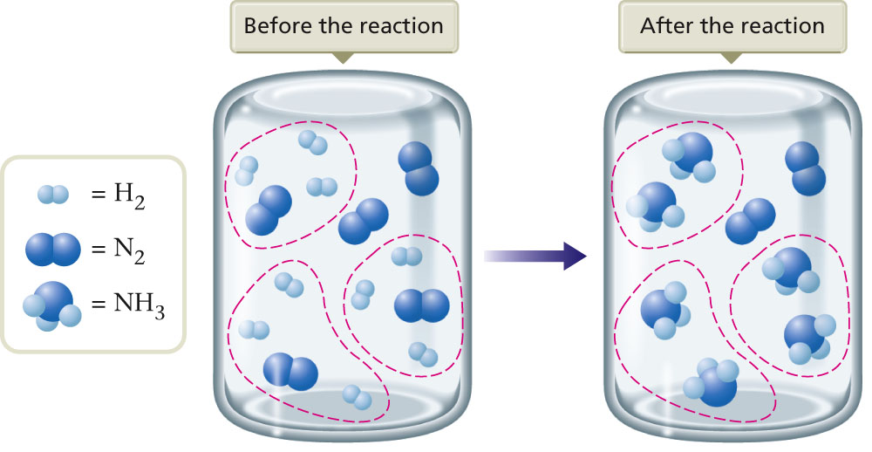
Limiting Reactants, continued
N₂(g) + 3H₂(g) → 2NH₃(g)
What is left over?
Limiting Reactant:
  Consumed first and completely.
  Limits the extent of a reaction – meaning, it limits the amount of product formed.
Hydrogen (H₂)
Excess Reactant:
  Any other reactant not used up completely after a reaction.
Nitrogen (N₂)

Slide 24
Solving Stoichiometry Problems Involving Limiting Reactants
Write and balance the equation for the reaction.
Convert known masses of reactants to moles.
Using the numbers of moles of reactants and the appropriate mole ratios, determine which reactant is limiting.
Using the amount of the limiting reactant and the appropriate mole ratios, compute the number of moles of the desired product.
Convert from moles of product to grams of product, using the molar mass (if this is required by the problem).

Slide 25
Solving Stoichiometry Problems Involving Limiting Reactants, continued
Question: Lithium oxide is used aboard the space shuttle to remove water from the air supply according to the following balanced equation.
Li₂O(s) + H₂O(g)
2LiOH(s)
If 80.0 g of water is to be removed and 65.0 g of Li₂O is available,
  Determine which reactant is limiting.
How many grams of excess reactant remain?
How many grams of LiOH are produced?
25

Slide 26
Solving Stoichiometry Problems Involving Limiting Reactants, continued
If 80.0 g of water is to be removed and 65.0 g of Li₂O is available, determine:
Which reactant is limiting?
Li₂O(s) + H₂O(g)
2LiOH(s)
mole ratio: 1 : 1 : 2
Convert mass of reactants to moles.
How many moles in 65.0 g Li₂O?
1 mol Li₂O
=
65.0 g Li₂O
×
(1) Compare reactants
29.9 g Li₂O
How many moles in 80.0 g H₂O?
(2) Amount of product given reactants
1 mol H₂O
80.0 g H₂O
×
=
18.0 g H₂O
26

Slide 27
Solving Stoichiometry Problems Involving Limiting Reactants, continued
(1) Compare reactants: Use mole ratio of reactants to calculate the amount of one reactant that is needed to react with the given amount of the other reactant.
Li₂O(s) + H₂O(g)
2LiOH(s)
mole ratio 1 : 1 : 2
1 mol H₂O
2.17 mol Li₂O
×
=
1 mol Li₂O
1 mol Li₂O
4.44 mol H₂O
×
=
1 mol H₂O
______ is the limiting reactant.
______ is the excess reactant.
(2) Amount of product given reactants?
27

Slide 28
Solving Stoichiometry Problems Involving Limiting Reactants, continued
(2) Amount of product given reactants: Use mole ratio to calculate which reactant produces the least amount of product:
Li₂O(s) + H₂O(g)
2 LiOH(s)
mole ratio 1 : 1 : 2
2 mol LiOH
_______ product
2.17 mol Li₂O
×
=
1 mol Li₂O
2 mol LiOH
4.44 mol H₂O
×
=
_______ product
1 mol H₂O
28

Slide 29
Solving Stoichiometry Problems Involving Limiting Reactants, continued
If 80.0 g of water is to be removed and 65.0 g of Li₂O is available,
(b) How many grams of excess reactant remain?
Li₂O(s) + H₂O(g)
2LiOH(s)
4.44 mol – 2.17 mol = 2.27 mol
18.0 g H₂O
2.27 mol H₂O
×
=
1 mol H₂O
excess
29

Slide 30
Limiting Reactants, continued
If 80.0 g of water is to be removed and 65.0 g of Li₂O is available,
(c) How many grams of LiOH are produced?
Li₂O(s) + H₂O(g)
2LiOH(s)
30

Slide 31
Yield of Chemical Reaction
An important indicator of the efficiency of a particular laboratory or industrial reaction.
Theoretical Yield: maximum amount of a given product that can be formed when the limiting reactant is completely consumed. (Amount predicted using balanced equations and calculations).
Experimentally, reactions are never 100% efficient and product is lost along the way (by-products of reaction, lost during isolation, etc.). The actual amount of product recovered is called the actual yield.
Actual Yield: Actual amount produced in a reaction.
31

Slide 32
Yield of Chemical Reactions, continued
Percent Yield: Ratio of actual yield to theoretical yield, expressed as a percentage.
Actual yield of product
% Yield =
× 100%
Theoretical yield of product
or
What you got
x 100% = percent yield
Maximum possible
32

Slide 33
Yield of Chemical Reactions, continued
Question: If 80.0 g of water reacts with 65.0 g of Li₂O to give 90.6 g of LiOH, what is the percent yield of the reaction?
Li₂O(s) + H₂O(g)
2LiOH(s)
m = 104 g LiOH
Theoretical Yield
Actual yield of product
% Yield =
× 100%
Theoretical yield of product
% Yield =
33

Slide 34
Yield of Chemical Reactions, continued
Percent Atom Economy: Ratio of the molecular weight of the desired product to the molecular weight(s) (MW) of the reactants, expressed as a percentage.
∑ MW (desired product)
% Atom Economy =
× 100
∑ MW (reactants)
Or Total Products
How much of the reactants end up as the 'desired' product.
Greater % atom economy = more 'efficient' or 'economic’ the reaction.
VIDEO: What Is the Atom Economy?
34

Slide 35
Yield of Chemical Reactions, continued
∑ MW (desired product)
% Atom Economy =
× 100
∑ MW (reactants)
Fe₂O_{3(s)} + 3CO_{(g)} → 2Fe_{(l)} + 3CO_{2(g)}
MW (g/mol) = 159.687 28.01 55.845 44.009
2 x MW_{Fe}
% Atom Economy =
× 100%
MW_{Fe2O3} + 3 x MW_{CO}
=
2 x 55.845
= 45.83%
× 100%
159.687 + 3 x 28.01
35

Slide 36
Khan Academy: Worked Example - Calculating Amounts of Reactants and Products (video, 12:05)
Khan Academy: Worked Example - Calculating the amount of product formed from a limiting reactant (video, 6:21)
Professor Dave: Practice Problem - Limiting Reagent and Percent Yield (video, 9:07)
How to Calculate Theoretical Yield and Percent Yield (video: 6:23)

