Slide 1
Worked Examples with ANSWERS
Unit 4
Reactions in Aqueous Solutions

Slide 2
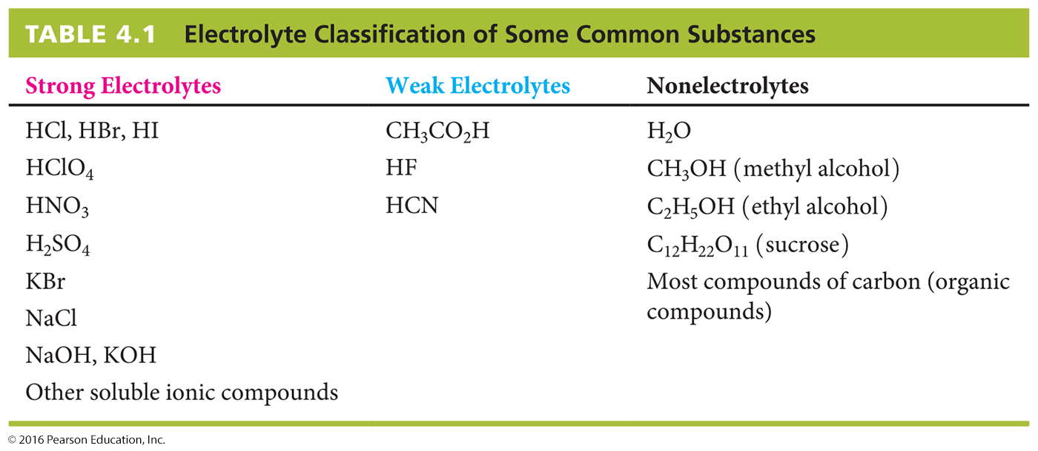
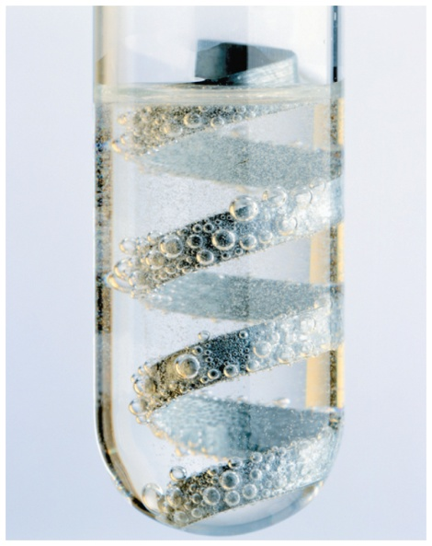
Example 1 Writing a Net Ionic Equation
Aqueous hydrochloric acid reacts with zinc metal to yield hydrogen gas and aqueous zinc chloride. Write a net ionic equation for the process and identify the spectator ions.
2 HCl(aq) + Zn(s) → H₂(g) + ZnCl₂(aq)
Answer
Write the ionic equation, listing all the species present in solution. Table 4.1 tells us that both HCl (molecular compound) and ZnCl₂ (a soluble ionic compound) are strong electrolytes that exist as ions in solution. Then find the ions that are present on both sides of the reaction arrow—the spectator ions—and cancel them to leave the net ionic equation.
Answer is on the following slide.

Slide 3
Example 1 Writing a Net Ionic Equation
(continued)
Answer
Ionic Equation
2 H⁺(aq) + 2 Cl–(aq) + Zn(s) → H₂(g) + Zn²⁺ (aq) + 2 Cl–(aq)
Chloride ion is the only spectator ion in this reaction.
Net Ionic Equation
2 H⁺(aq) + Zn(s) → H₂(g) + Zn²⁺ (aq)
Question
(1) Write net ionic equations for the following reactions:
(a) 2 AgNO₃(aq) + Na₂CrO₄(aq) → Ag₂CrO₄(s) + 2 NaNO₃(aq)
(b) H₂SO₄(aq) + MgCO₃(s) → H₂O(l) + CO₂(g) + MgSO₄(aq)
(c) Hg(NO₃)₂(aq) + 2 NH₄I(aq) → HgI₂(s) + 2 NH₄NO₃(aq)
Answers are in the notes below.
Notes:
2Ag⁺ (aq) + CrO₄²⁻(aq) → Ag₂CrO₄(s)
2H⁺ (aq) + MgCO₃(s) → H₂O(l) + CO₂(g) + Mg²⁺(aq)
Hg²⁺ (aq) + 2I⁻(aq) → HgI₂(s)

Slide 4
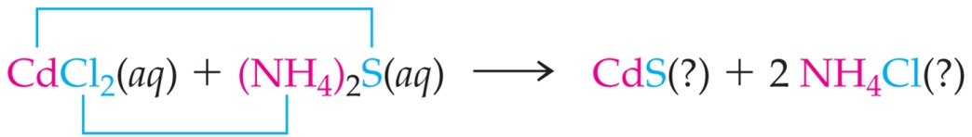
Example 2 Predicting the Product of a Precipitation Reaction
Will a precipitation reaction occur when aqueous solutions of CdCl₂ and (NH₄)₂S are mixed? If so, write the net ionic equation.
Answer
Determine the possible products of the reaction by combining the cation from one reactant with the anion from the other reactant.
Predict the solubility of each product using the guidelines in Table 4.2. on the next slide.
Answer is in the notes below.
Notes:
Cd²⁺ (aq) + S^{2–}(aq) → CdS(s)

Slide 5
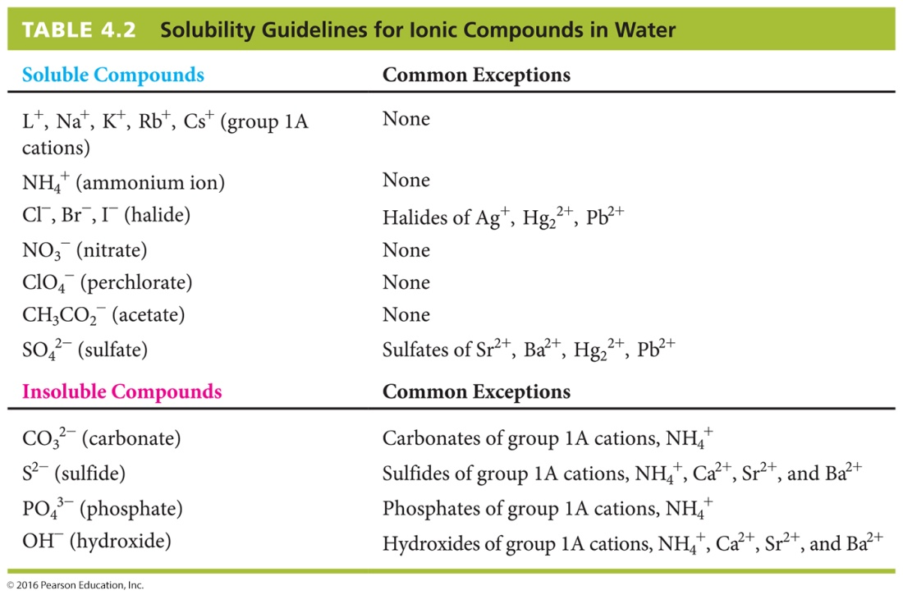
Example 2 Predicting the Product of a Precipitation Reaction
(continued)

Slide 6
Example 2 Predicting the Product of a Precipitation Reaction
(continued)
Question:
(2) Predict whether a precipitation reaction will occur in each of the following situations. Write a net ionic equation for each precipitation reaction that occurs.
(a) NiCl₂(aq) + (NH₄)₂S(aq) → ?
(b) Na₂CrO₄(aq) + Pb(NO₃)₂(aq) → ?
(c) AgClO₄(aq) + CaBr₂(aq) → ?
(d) ZnCl₂(aq) + K₂CO₃(aq) → ?
Answers are in the notes below.
Notes:
(a) NiCl₂(aq) + (NH₄)₂S(aq) → NiS(?) + 2NH₄Cl(?)
Ni⁺²(aq) + 2Cl⁻¹(aq) + 2NH₄⁺¹(aq) + S²⁻(aq) → NiS(s) + 2NH₄⁺¹(aq) + 2Cl⁻¹(aq)
Ni⁺²(aq) + S²⁻(aq) → NiS(s)
Na₂CrO₄(aq) + Pb(NO₃)₂(aq) → 2NaNO₃ (?) + PbCrO₄(?)
2Na⁺¹(aq) + CrO₄²⁻ (aq) + Pb²⁺(aq) + 2NO₃¹⁻ (aq) → 2Na⁺¹(aq) + 2NO₃¹⁻ (aq) + PbCrO₄(s)
CrO₄²⁻ (aq) + Pb²⁺ (aq) → PbCrO₄(s)
(c) 2AgClO₄(aq) + CaBr₂(aq) → 2AgBr (?) + Ca(ClO₄)₂ (?)
2Ag⁺(aq) + 2ClO₄⁻ (aq) + Ca²⁺(aq) + 2Br⁻ (aq) → 2AgBr (s) + 2ClO₄⁻ (aq) + Ca²⁺(aq)
2Ag⁺(aq) + 2Br⁻ (aq) → 2AgBr (s)
(d) ZnCl₂(aq) + K₂CO₃(aq) → ZnCO₃(?) + 2KCl(?)
Zn²⁺(aq) + 2Cl⁻(aq) + 2K⁺(aq) + CO₃²⁻(aq) → ZnCO₃(s) + 2Cl⁻(aq) + 2K⁺(aq)
Zn²⁺(aq) + CO₃²⁻(aq) → ZnCO₃(s)

