Slide 1
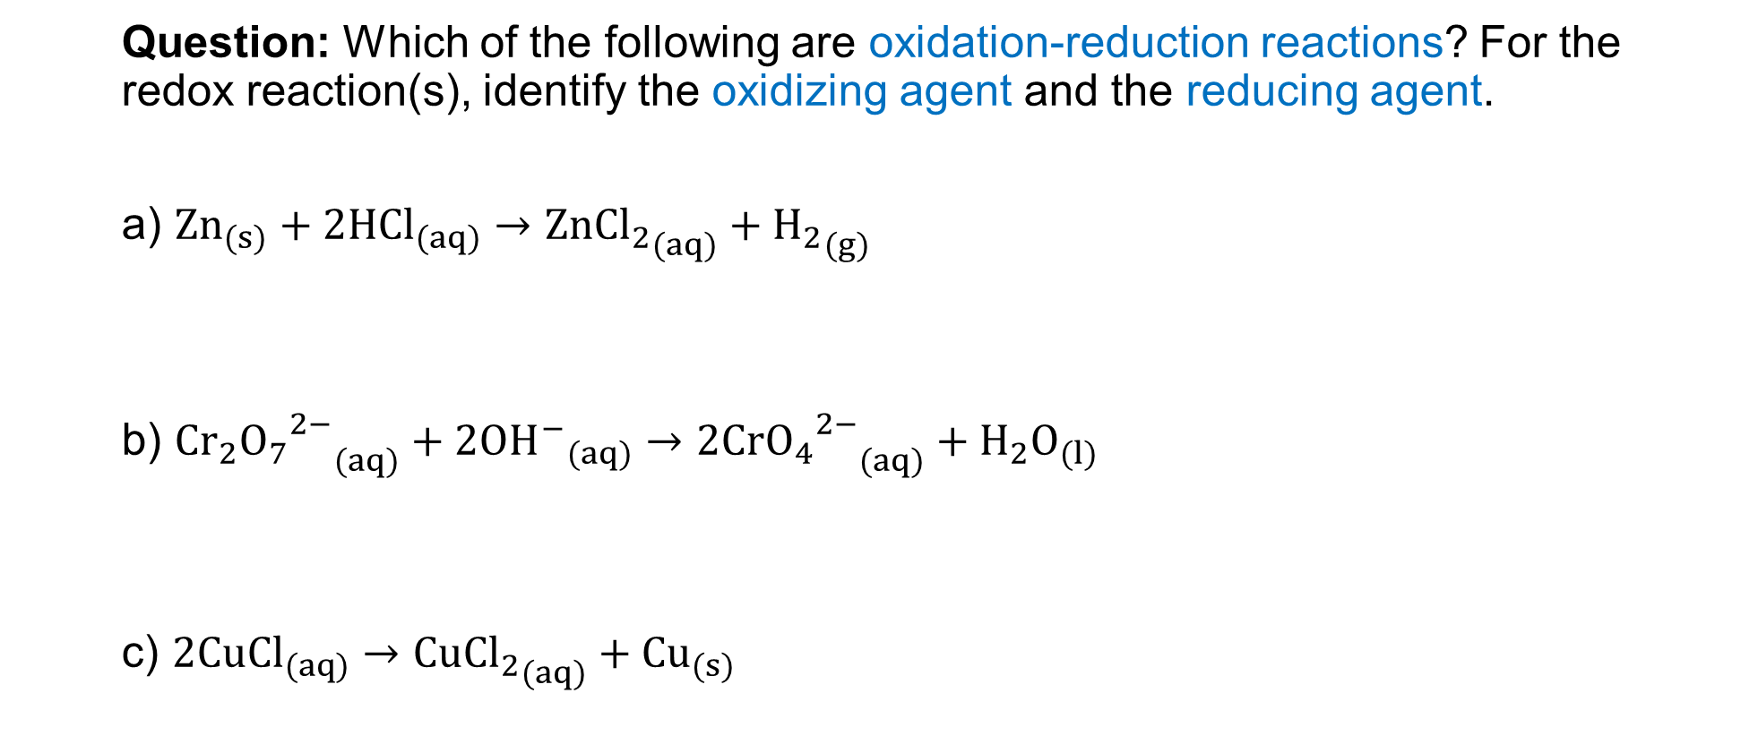
Question: Which of the following are oxidation-reduction reactions? For the redox reaction(s), identify the oxidizing agent and the reducing agent.
${Zn}_{(s)}+2{HCl}_{(aq)}→{Zn{Cl}_{2}}_{(aq)}+{H_{2}}_{(g)}$
${{{Cr}_{2}O_{7}}^{2−}}_{(aq)}+{2{OH}^{−}}_{(aq)}→{{2CrO_{4}}^{2−}}_{(aq)}+{H_{2}O}_{(l)}$
$2{CuCl}_{(aq)}→{Cu{Cl}_{2}}_{(aq)}+{Cu}_{(s)}$
Notes:
Zn is the reducing agent; HCl is the oxidizing agent
Not a redox reaction
c) CuCl acts as the reducing and oxidizing agent

