Slide 1

Unit 5
Periodicity and the structure of atoms

Slide 2
Understanding atomic structure and properties
Key Topics
Part 1: Using the Electromagnetic Spectrum
Part 2: Particle-like properties of light
Part 3: Quantum Mechanical Model the Atom
Chapter 5 etextbook
2

Slide 3
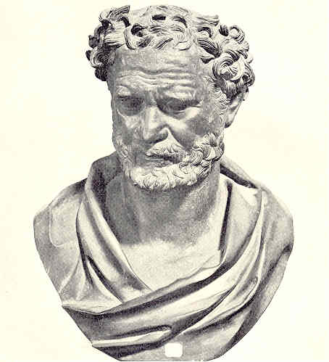
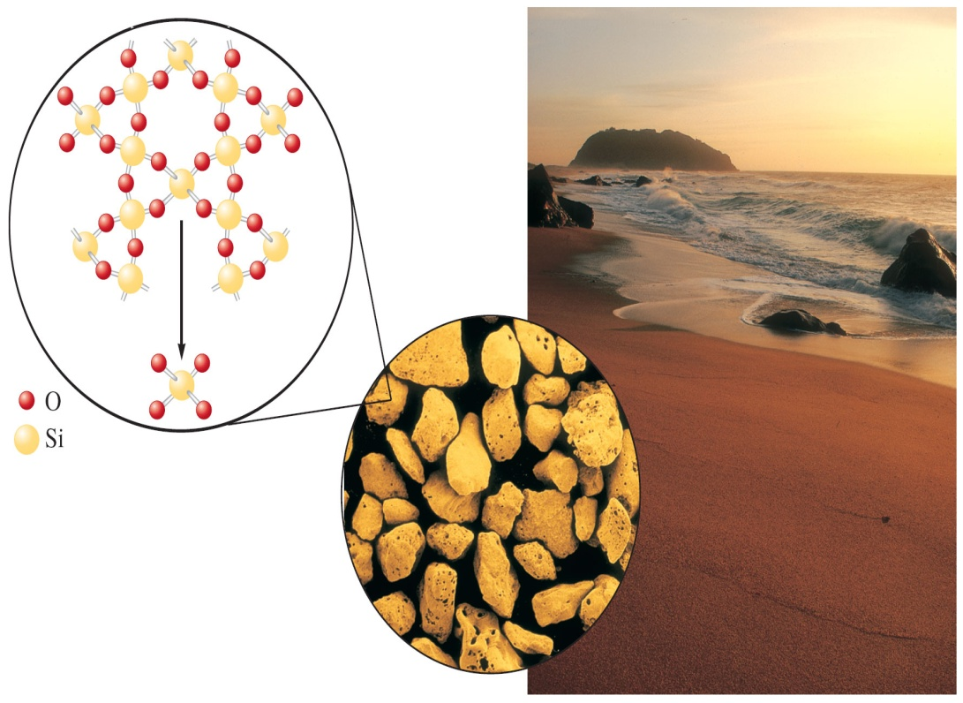
Early Atomic Structure
The idea of the atom goes back to Democritus and the Ancient Greeks at about 400 B.C.

Slide 4
What is an atom?
What is inside an atom?
How do we learn more about it?
4

Slide 5
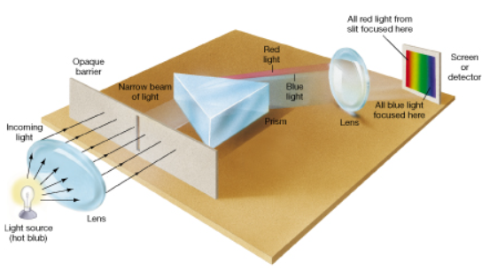
Spectroscopy
Uses light to study matter.
Matter – atoms, molecules - absorbs and releases light, a spectroscope can provide information about the structure of matter.
  prism
  detector
  slit
  Light source
Figure 1: Simple spectroscope.
5

Slide 6

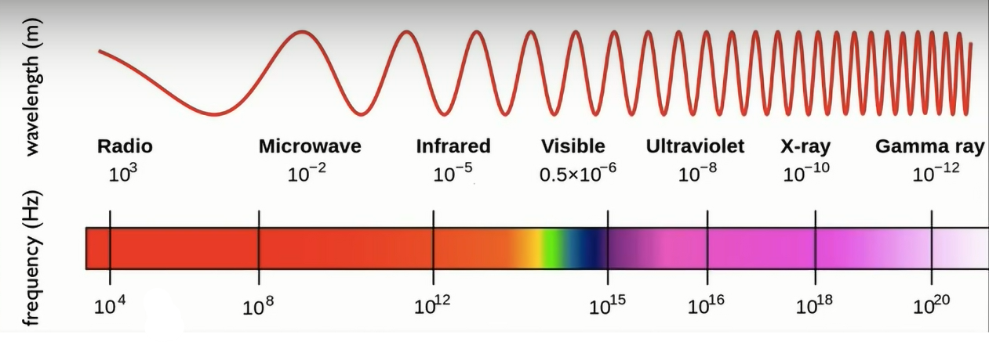
Dual Nature of Light
  Light can travel as and .
As waves:
Light travels through space (vacuum) as (EM).
Electromagnetic spectrum includes all types of EM energy (light, radiation, radiant energy), such as : __________________________________
6
Notes:
Particles and waves
Electromagnetic energy
Radio waves, infrared radiation …. Gamma rays ….

Slide 7
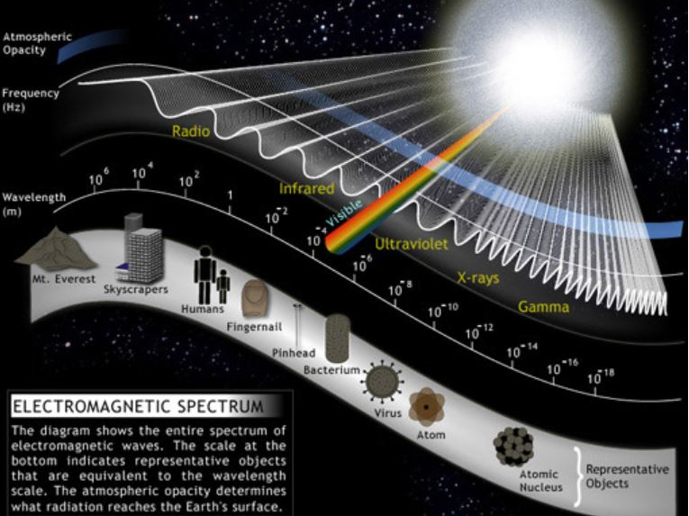
Wave Properties of Radiant Energy
7

Slide 8
Wave Properties of Radiant Energy, continued
Activity: Watch this video, answer the following questions.
TED-Ed video (5:57): Light waves, visible and invisible.
What is light?
Use one word to describe “wavelength”? “Frequency”?
Wavelength and frequency are directly / indirectly proportional.
As wavelength increases, frequency increases / decreases.
What makes one kind of light different from another?
How can we study light without seeing it?
8

Slide 9
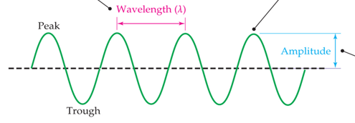
Wave Properties of Radiant Energy, continued
Properties of electromagnetic energy:
Frequency (ν) – _________ of waves (cycles) that pass a given point in space per second (Hertz, Hz, or s⁻¹, cycles/second).
Wavelength (λ) – _________ between two peaks or troughs in a wave (m, meters).
Amplitude – maximum height of a wave measured from its centre. Affects intensity of light.
9
Notes:
Distance
number

Slide 10
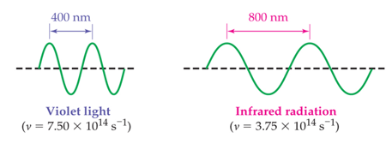
Wave Properties of Radiant Energy, continued
Types of EM energy differ in terms of wavelengths and frequencies:
Wavelength (λ) and frequency (v) are proportional.
10
Notes:
inversely

Slide 11
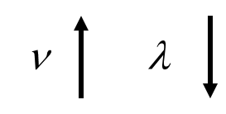
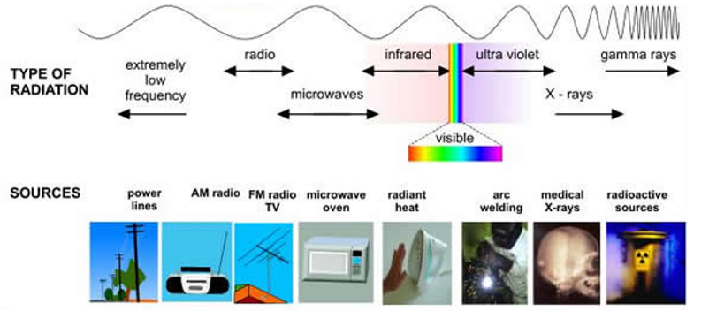
Wave Properties of Radiant Energy, continued
Radio waves have wavelengths and _____ frequencies.
Gamma rays have wavelengths and frequencies.
Energy increases
11
Notes:
Long, low
Short, high

Slide 12
Wave Properties of Radiant Energy, continued
The relationship between wavelength and frequency gives the speed of a wave.
Wavelength x Frequency = Speed
Electromagnetic energy in a vacuum travels at a constant speed:
Speed of Light, c
c =
2.9979 x 10⁸ m/s
or
3.00 x 10⁸ m/s
12

Slide 13
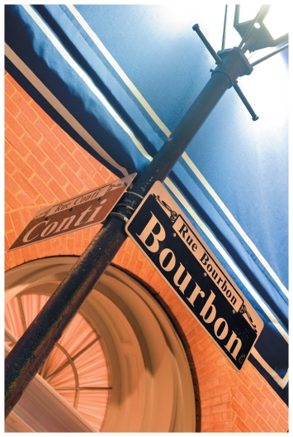
Wave Properties of Radiant Energy, continued
Question: Streetlamps filled with mercury gas emit a blue light. Sodium
lamps emit yellow light.
  Light from sodium has a wavelength of ~ 589 nm. If a mercury streetlamp has a frequency of 6.88 × 10¹⁴ s⁻¹ (or Hz), what is its wavelength in nanometers?
  Does blue light correspond to a longer or shorter wavelength than yellow?
Answer:
13
Notes:
λ = c / ν
3.00 × 10⁸ m/s / 6.88 × 10¹⁴ 1/s
= 436 nm

Slide 14
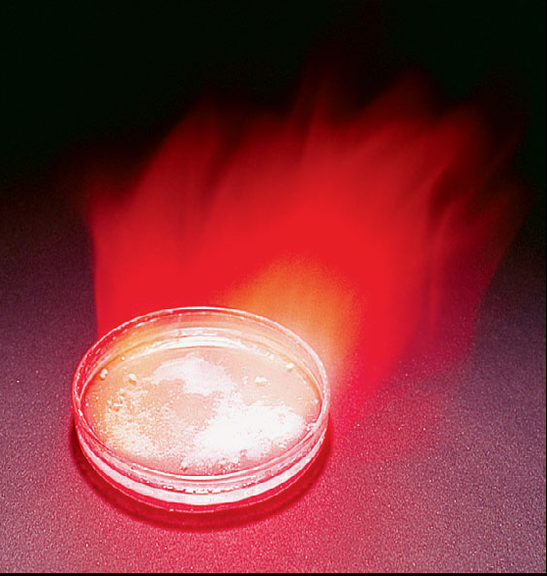
Wave Properties of Radiant Energy, continued
Question: The brilliant red colours seen in fireworks are due to the emission of light with wavelengths around 650 nm when strontium salts, such as Sr(NO₃)₂ and SrCO₃, are heated.
Calculate the frequency of red light of wavelength 6.50 x 10² nm.
Answer:
14
Notes:
3.00 × 10⁸ m/s / 6.50 × 10² nm
= 4.61 x 10¹⁴ s⁻¹
= 4.61 x 10¹⁴ Hz

Slide 15
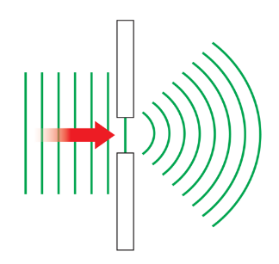

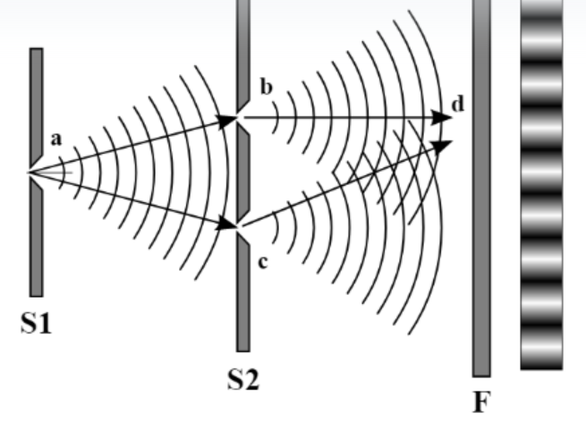
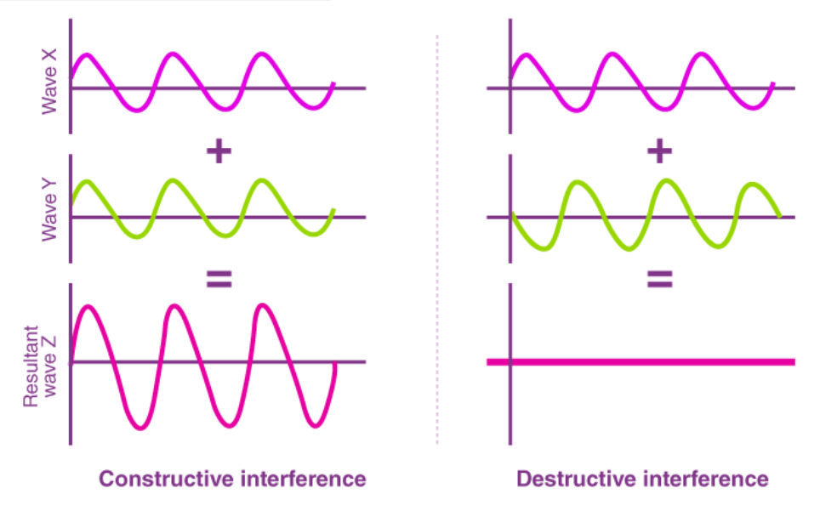
Wave Properties of Radiant Energy, continued
Support for light travelling as waves: Diffraction and Interference
Diffraction is the bending of light around an object.
Light
Interference is when light waves interact with each other and the amplitude of the resulting waves either increase or decrease.
15
Notes:
Interference is the phenomenon that arises when two or more waves meet at the same place and their amplitudes add in a way that they are either constructive or destructive depending on their relative phases.

Slide 16
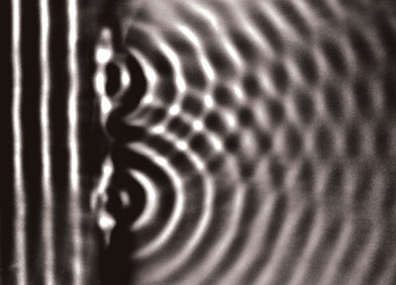
Wave Properties of Radiant Energy, continued
Both water waves and light show diffraction and interference patterns so light can be described as a wave!
16

Slide 17
Wave Properties of Radiant Energy, continued
Wave Properties of Radiant Energy
  Worked Example 5.1 Calculating Frequency from Wavelength.
  Practice 5.1 and Conceptual Apply 5.2
  End of the Chapter Section Problems in the etext: 5.34, 5.35, 5.36
End of Part 1
17

