Slide 1
Chemical Bonding
Unit 6 – Chapter 7

Slide 2
Key Contents
05
06
07
Lewis Structures
Resonance
Formal Charges

Slide 3
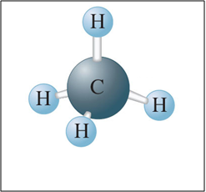
The Model of the Covalent Chemical Bond
Bonds result from the tendency of a system to seek its lowest possible energy.
Bonding is a model proposed to explain molecular stability.

Slide 4
Models
Models are attempts to explain how nature operates on the microscopic level based on experiences in the macroscopic world.
Without the concepts of individual bonds in molecules, chemists would have a very difficult time understanding the behavior of millions of chemical compounds.

Slide 5
Fundamental Properties of Models
A model does not equal reality.
Models are oversimplifications and are therefore often wrong.
Models become more complicated and are modified with time.
We must understand the underlying assumptions in a model so that we don’t misuse it.
When a model is wrong, we often learn much more than when it is right.

Slide 6

05
Lewis Structures

Slide 7
Lewis Structures
Shows the arrangement of valence electrons as among atoms in a molecule.
Fluorine has 7 valence electrons.
Valence electrons represented as dots.
7

Slide 8
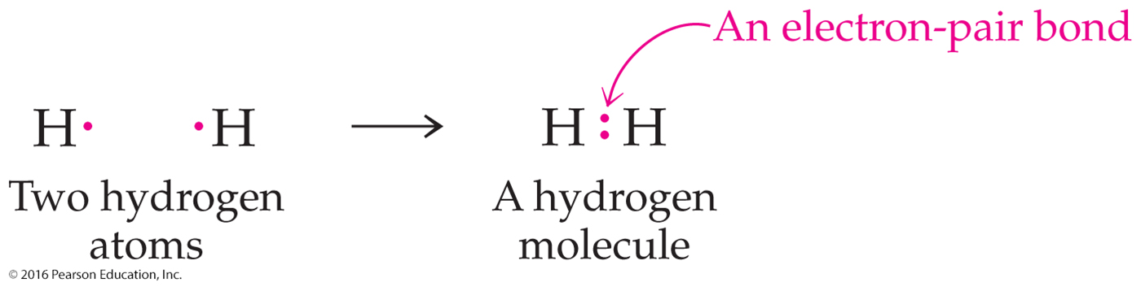
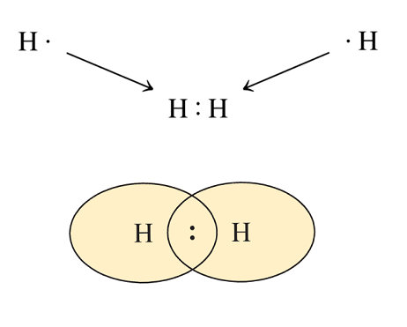
Lewis Structures, continued
Duet Rule:
  Hydrogen forms stable molecules when it shares two electrons.
  By sharing, each hydrogen has a filled valence shell.
8

Slide 9
Lewis Structures, continued
Octet Rule:
  Elements form stable molecules when surrounded by eight electrons.
  Period 2 elements always obey this rule to gain a noble gas configuration.
+
Lone pairs - pairs of electrons not involved in bonding.
Bonding pairs - pairs of electrons shared between atoms.
Preferred Representation

Slide 10
Covalent Bonds
Lewis Structures, continued
Single covalent bond - two atoms share one pair of electrons.
H–H
Double covalent bond - two atoms share two pairs of electrons.
O=C=O
Triple covalent bond - two atoms share three pairs of electrons.

Slide 11
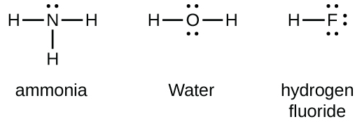

Lewis Structures, continued
Professor Dave "Lewis Dot Structures" (video, 4:40)
Lewis Diagrams Made Easy (video, 7:26)
11

Slide 12
Lewis Structures, continued
Steps:
  1: Count valence electrons
  2: Connect atoms
  3: Assign electrons to the terminal atoms
  4: Assign electrons to the central atom
  5: Multiple bonds
12

Slide 13
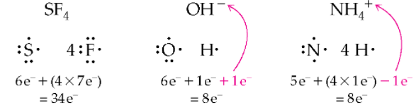
Lewis Structures, continued
Step 1: Count Valence Electrons
  Add the total number of valence electrons for all atoms in the species.
  If species has a charge:
    Add one more electron for a negative charge (anion)
    Subtract one for each positive charge (cation).
13

Slide 14
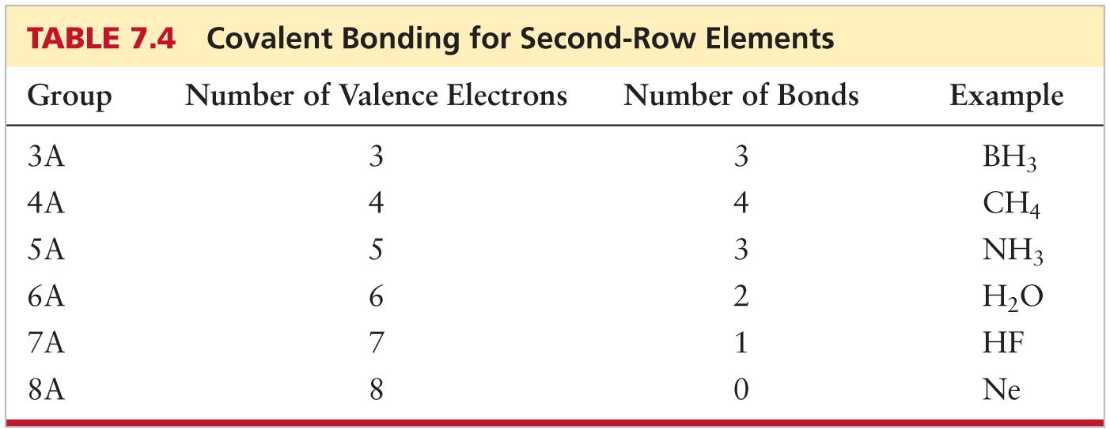
Lewis Structures, continued
Step 2: Connect Atoms
  Place atoms with the lowest EN (except hydrogen) in the middle.
  Draw lines to represent bonds.
    Hydrogen and halogens usually form one bond.
    2nd row elements usually form number of bonds based on their group #.
    3rd row (and lower) are usually the central atom and form more bonds than expected.
14

Slide 15
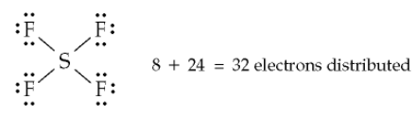
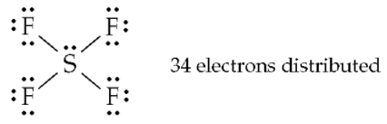
Lewis Structures, continued
Step 3: Assign Electrons to the Terminal Atoms
  Total # electrons - # bonding electrons = # electrons left over
  Use them to complete octet of each terminal atom (except for hydrogen’s).
Total of 34 electrons – 8 (in bonds) = 24 remaining
Step 4: Assign Electrons to the Central Atom
  If unassigned electrons remain, place them on the central atom.
15

Slide 16
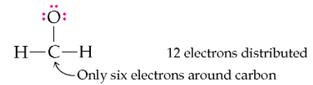
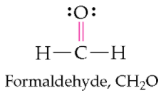
Lewis Structures, continued
Step 5: Multiple Bonds
  If there are no more unassigned electrons after Step 4 BUT the central atom does not yet have an octet, use one or more lone pairs of electrons from a neighboring atom to form a multiple bond (either a double or a triple).
16

Slide 17
Guidelines for Writing Skeletal Structures
  Hydrogen atoms are always terminal atoms.
  Carbon atoms are always central (bonded to 2 or more atoms) atoms.
  Central atoms are generally those with the lowest electronegativity.
  Small molecules and polyatomic ions generally have compact, symmetrical structures.

Slide 18
Guidelines for Writing Skeletal Structures
4) Small molecules and polyatomic ions generally have compact, symmetrical structures.
Potential skeletal structures for H₃PO₄
Correct skeletal structure for H₃PO₄

Slide 19
Lewis Structures, continued
(1) Draw a Lewis structure for H₂O.
Step 1: Add up all valence electrons.
Step 2: Connect atoms.
Step 3: Complete terminal atoms octets (except hydrogen)
Step 4: Assign e⁻ to central atoms.
Step 5: Multiple bonding?
19

Slide 20
Lewis Structures, continued
(2) Draw a Lewis structure for CO₂.
C: ___ valence e⁻
O: ___ valence e⁻ x 2 = ____
16 - 4 = ___ valence e⁻ left
Put the remaining valence e⁻ on O will give them a filled octet.
___ valence e⁻
Carbon atoms are almost always central atom.
BUT C only has 4 valence e⁻!

Slide 21
Lewis Structures, continued
Draw the Lewis Structure of CO₂
Move the lone pair electrons on O to make double bonds with C.
This will give C a filled octet.
All atoms in this structure have a filled octet!

Slide 22
Lewis Structures, continued
(3) Draw a Lewis structure for CCl₄.
Step 1:
Step 2:
Step 3:
22

Slide 23
Lewis Structures, continued
(4) Draw a Lewis structure for [H₃O]⁺
Step 1:
Step 2:
Step 4:
23

Slide 24
Lewis Structures, continued
(5) Draw a Lewis structure for CH₂O.
24

Slide 25
Octet Rule Exceptions
Expanded octet
Second row elements C, N, O and F always follow the octet rule.
Elements in the 3rd (and beyond) can have an expanded octet because of empty d orbitals available in the valence shell.
Electron deficient elements
Second row B and Be often have incomplete octets.
Exceptions to the Octet Rule (Khan Academy video 7:09)
25
Notes:
The octet “rule” is more of a guideline. Watch the row three or greater central atoms.

Slide 26
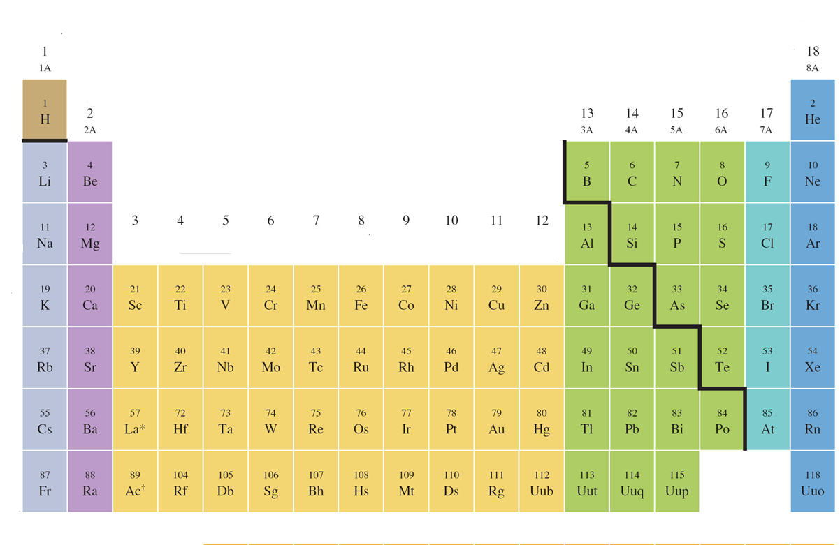
Octet Rule Exceptions, continued
Quantum Numbers and d Orbitals
d orbitals
When n = 3, l = 0, 1, or 2
1
2
3
4

Slide 27
Octet Rule Exceptions, continued
Second row elements C, N, O and F always follow the octet rule.
Second row elements B and Be often have incomplete octets.
Third row elements (and beyond) can have expanded octets because of empty d orbitals available in the valence shell.
When writing the Lewis structure for a molecule, satisfy the octet rule for the atoms first. If electrons remain after the octet rule has been satisfied, then place them on the elements having available d orbitals (elements in Period 3 or beyond).

Slide 28
Octet Rule Exceptions, continued
(6) Draw a Lewis structure for SF₆.
28
Notes:
When writing the Lewis structure for a molecule, satisfy the octet rule for the atoms first.
If electrons remain after the octet rule has been satisfied, then place them on the elements having available d orbitals (elements in Period 3 or beyond).

Slide 29
Octet Rule Exceptions, continued
(7) Draw a Lewis structure for ICl₃.
29

Slide 30
Octet Rule Exceptions, continued
Electron deficient elements
Second row B and Be often have incomplete octets
Draw the Lewis Structure of BF₃
B: ____ valence e⁻
F: ____ valence e⁻ x 3 = ____
Total # valence e⁻: ____

Slide 31
Lewis Structures, continued
Question: What criteria must be met in a valid electron-dot structure?
The least EN atom should be the central atom.
Each atom must have an octet unless the atom is an exception (ex. Expanded octet).
The number of electrons in the electron-dot structure must equal the sum of valence electrons of all the atoms.
All of the above.
Question: Draw an electron-dot structure for OF₂.
Notes:
d

Slide 32
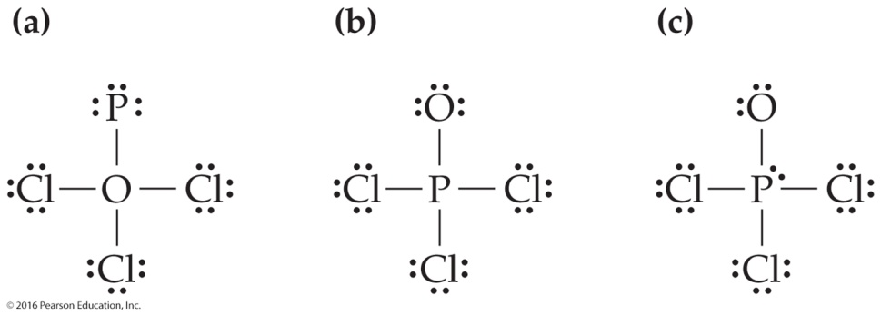
Lewis Structures, continued
Question: a) Identify the correct electron-dot structure for POCl₃.
  b) Explain what is wrong with the incorrect ones.
Notes:
B is correct
A is incorrect because the least electronegative atom (P) should be in the centre.
C is incorrect because oxygen does not have a complete octet.

Slide 33
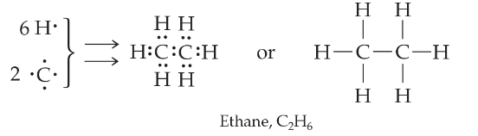
Lewis Structures of Organic Compounds
Organic compounds:
Example: Draw an electron-dot structure for ethene, C2H2 (fuel).
33

Slide 34
Lewis Structures of Organic Compounds
Question: Acetylene, C₂H₂, is an organic compound commonly used as a fuel for torches and as a starting material in chemical synthesis. Draw its Lewis structure.
Answer:
Follow the steps for a typical Lewis structure.
1: Count valence electrons
2: Connect atoms

Slide 35
Lewis Structures of Organic Compounds
3: Assign electrons to the terminal (end) atom(s)
4: Assign electrons to the central atom
5: Multiple bonds

Slide 36
Resonance
06

Slide 37
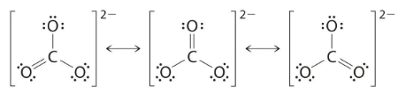
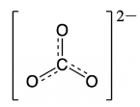
Resonance Structures
Used to describe molecules in which no Lewis one structure is consistent with observed properties.
The actual molecule is a “hybrid” of these structures.
Example: Carbonate ion, CO₃²⁻
Double-headed arrow
All structures contribute to the resonance hybrid.
Resonance hybrid
Solid and dash lines indicate a bond with properties between those of a single and double bond.
Khan Academy: Resonance and Dot Structures (6:14)
37

Slide 38
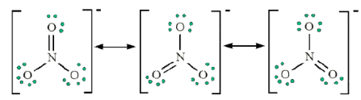
Resonance, continued
How do you know if resonance structures are needed?
Double bond and a lone pair.
When drawing resonance structures for the same molecule:
  Draw Lewis structures as usual.
  Same total # valence electrons.
  Same relative positions of the atoms.
  Only electrons can move.
  As a result, the position of the following may change:
Resonance structures for the Nitrate ion, NO₃¹⁻
    Charges
    Double bonds
    Lone pairs of electrons
38
Notes:
The structure changes between resonance forms when electron pairs shift between nonbonding and bonding orbitals.

Slide 39


Resonance, continued
Are these resonance structures?
39
Notes:
Structure on the left:
Lewis diagram as expected.
Same total # valence electrons.
Same relative positions of the atoms.
Only electrons moved:
Charges
Double bonds
Lone pairs of electrons
Structure on the right:
Same molecular formula (NHC=O) and # valence electrons.
Incorrect connectivity

Slide 40

Resonance, continued
Question: Draw a Lewis diagram for ozone, O₃.
Total number of valence electrons = 3(6) = 18
Use 4 electrons for the bonds.
O O O
18 - 4 = 14 … to be placed first on the terminal oxygens to have a full octet.
. . .. . .
:O O O:
. . . .
How to get the central oxygen with a full octet?
Move one of the lone pairs from the terminal oxygens to form a double bond.
. . .. . .
:O O O:
. .
. . .. . .
:O O O:
. .
Coordinate covalent bond : shared electrons come from the same atom.
40

Slide 41
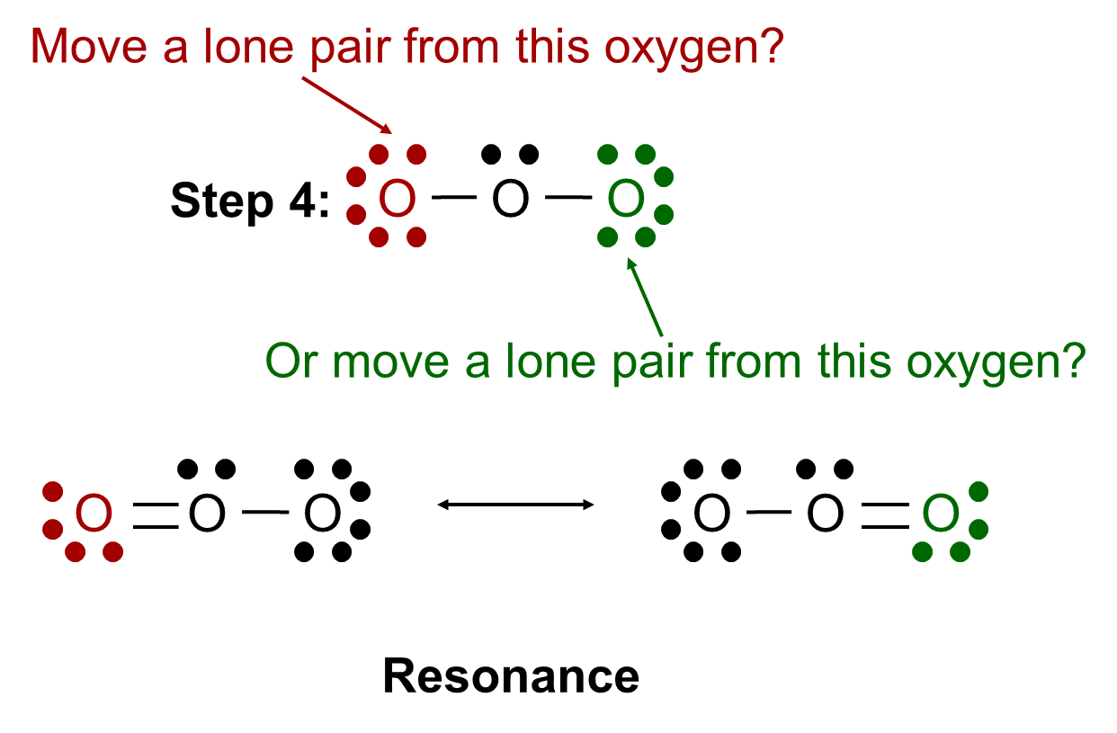
Resonance, continued
41

Slide 42
Formal Charges
07

Slide 43
Formal Charges
Compares the number of valence of electrons in an isolated neutral atom with the number of valence electrons around this atom in a molecule (electron book-keeping).
Formal Charge = Group Number - (Number of bonds) – (Number of e⁻ in lone pair e⁻)
43

Slide 44

Formal Charges, continued
Question: Calculate the formal charge on each atom in this Lewis structure for SO_{2.}
Khan Academy: Formal Charge and Dot Structures (11:29)
44

Slide 45
Question: For the following molecule, CO₃⁻²
(a) Draw Lewis structures (would it be best represented with resonance structures?)
(b) Calculate and indicate the formal charge of each atom.
Resonance Structures (video 5:24)
45

